Slide 1

Adversarial Attacks and Defenses in Machine Learning
School of Computer Science and Engineering
Department of Computer Science and Engineering
Submitted By: AARNA GUPTA
2427030695
Supervised By: DR. NEHA JANU

Slide 2
Outline
Introduction
Literature Review
Problem Statement
Proposed Solution
Objectives

Slide 3
Introduction
Adversarial Attacks are Subtle manipulations of input data that mislead AI models into making wrong predictions.
samples into the training dataset to degrade model performance.
Threatens critical applications like facial recognition, autonomous driving, and malware detection.
Exposes vulnerabilities in AI systems due to their statistical and data-driven nature.
Highlights the need for robust and resilient AI models that can detect and resist such manipulations.

Slide 4
Introduction
AI and ML systems are now embedded in critical domains — from healthcare and finance to self-driving vehicles and cybersecurity. Even minor manipulations in input data can cause major errors in prediction or decision-making. Attackers exploit the data-driven nature of AI to cause system failures or gain unauthorized access.
Examples: Slightly modified traffic signs misleading autonomous cars. Poisoned datasets making malware detectors ignore new threats.

Slide 5
Literature Review
Author & Year | Methods | Focus Area | Limitations
Vassilev, Oprea, Fordyce, Anderson, Davies, Hamin (2023) | Comprehensive taxonomy; attack classification (stage, goals, knowledge); mitigations: adversarial training | Taxonomy of adversarial ML attacks & defenses. | Conceptual; empirical defenses; lacks formal benchmarks; evolving threats.
Bena, Anisetti, Damiani, Yeun, Ardagna (2023) | Risk-based ensemble: assigns poisoning risk using indicators of poisoning IoPs (SVM, kNN, centroids), routes data via round-robin/sink strategy. | Defending against data poisoning using risk-aware ensembles. | Evaluated on small tabular datasets; limited generalization to deep learning.
Pawlicki, Pawlicka, Kozik, Choraś (2024) | Meta-survey (systematic review) of papers; categorization of deep-learning models and performance metrics; gap analysis. | Survey of adversarial attacks and detection in DL models. | Inconsistent paper selection; missing standard metrics; lacks structure.

Slide 6
Literature Review
Author & Year | Methods | Focus Area | Limitations
Ndayipfukamiye, Ding, Sarwatt, Philipo, Ning (2023) | PRISMA-based review; GAN taxonomy (defensive function, architecture, threat model). | GAN-based methods for cyber threat detection and mitigation. | GANs costly, unstable, and lack standardized benchmarks.
Lakera Team(2024) | Survey of poisoning vectors and supply-chain risks; tools: PoisonBench, MCPTox. | Data poisoning in generative AI pipelines. | Poisoning detection & recovery immature; stealthy attacks impactful.
Muthalagu, Malik, Pawar (2024) | Adversarial training & abstract interpretation; mixture of attacks for malware detection robustness. | Robust ML for malware evasion defense. | Dependent on adversarial sample quality; complex; dataset-sensitive.

Slide 7
Problem Statement
Vulnerabilities of AI Models to Adversarial Attacks
Machine learning models rely heavily on large and diverse datasets for training.
Attackers can manipulate these datasets or model inputs to intentionally cause incorrect predictions or degraded performance.
Such manipulations pose serious risks to critical applications — e.g., facial recognition, autonomous vehicles, healthcare, and cybersecurity. Adversarial manipulations can bypass traditional AI defenses and persistently weaken system security.
Minimal contamination (as little as 0.001% poisoned data) can cause significant shifts in model behavior.

Slide 8
Proposed Solution
Create an interactive web platform for adversarial ML research:
VISUALIZER: Side-by-side MNIST images (clean vs FGSM/PGD attacked) with slider epsilon change for interactiveness.
2. EXPERIMENT LAB: Pre-built runs experiments like (FGSM vs PGD) on accuracy/robustness stats
3. DEVELOPER LAB: Upload custom models/datasets → auto-run fixed attacks (ε=0.3) → eval + visualizations
4. BENCHMARKS: Compare vs baselines (TRADES, MART defenses) on CIFAR-10/MNIST
Tech: Streamlit (UI) + torchattacks (FGSM/PGD impl) + Plotly (charts)

Slide 9
Technique | Description | Limitation / Notes
FGSM | Fast Gradient Sign Method — single-step gradient-based attack that adds perturbation ε·sign(∇J) to input. | Less powerful; single-step makes it easier to defend against with simple thresholding.
PGD | Projected Gradient Descent — iterative extension of FGSM; applies multiple bounded steps. | Computationally expensive; stronger attack often used as benchmark for robustness.
Adversarial Training | Augments training data with adversarial examples (FGSM/PGD-generated) to improve model resilience. | Increases training time; may reduce accuracy on clean data if not balanced.
Noise Injection | Adds random Gaussian/uniform noise to inputs as a preprocessing step or during attack. | May be insufficient alone; useful as a hybrid component.
Input Preprocessing Defense | Applies filters (e.g., denoising, feature squeezing) to remove adversarial perturbations. | Can degrade clean accuracy; attacker may adapt to known preprocessing.
Confidence-Based Defense | Flags low-confidence predictions as potentially adversarial inputs. | Adaptive attacks can produce high-confidence adversarial examples.
Gradient Masking | Obscures gradient information to hinder gradient-based attacks. | Does not provide true robustness; attackers can use gradient estimation.
Tabl 1: Summary of adversarial attack and defense techniques reviewed

Slide 10
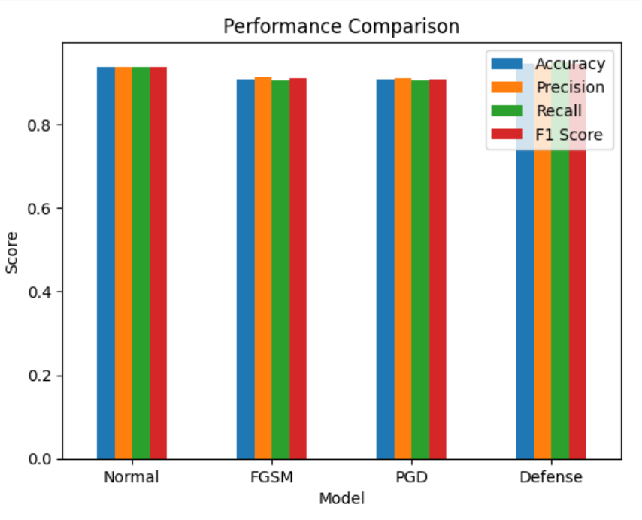
Novel Attack Concepts Under Investigation:
Hybrid Pipeline Attack: Chains FGSM (initial perturbation) + Gaussian noise injection + PGD (iterative refinement) to produce stronger, less predictable adversarial examples.
Confidence-Adaptive FGSM: Dynamically scales the perturbation epsilon based on the model's prediction confidence — applying larger perturbations to high-confidence predictions.
Class-Sensitivity Attack: Identifies which target classes are most vulnerable (have the lowest adversarial accuracy threshold) and focuses perturbations on cross-class boundaries for those classes.

Slide 11
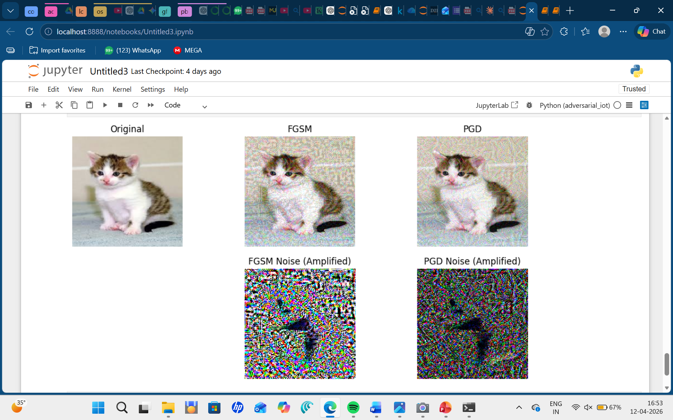
key findings included:
ML models are highly vulnerable to adversarial attacks, even with small perturbations (ε ≤ 0.1) causing significant accuracy drops
FGSM is fast but relatively weak; PGD is a stronger, iterative benchmark attack
Adversarial training is the most reliable empirical defense, though it comes at increased computational cost
fig. clean vs fgsm vs pgd (with increasing epsilon)

Slide 12
Objectives
Understand how adversarial attacks and data poisoning compromise AI models.
Evaluate existing attack types, mitigation strategies, and defense frameworks.
To evaluate the impact of varying epsilon values on model performance across multiple metrics
To explore novel attack strategies: hybrid pipelines, confidence-adaptive FGSM, class-sensitivity attacks
To survey and evaluate defense mechanisms including adversarial training, input preprocessing, and confidence-based detection
To lay the theoretical and experimental foundation for proposing a new attack or defense mechanism

Slide 13
References
Vassilev, A., Oprea, A., Fordyce, A., Anderson, H., Davies, X., & Hamin, M.Adversarial Machine Learning: A Taxonomy and Terminology of Attacks and Mitigations.NIST, 2023..
2. Bena, N., Anisetti, M., Damiani, E., Yeun, C. Y., & Ardagna, C. A.Protecting Machine Learning from Poisoning Attacks: A Risk-Based Approach.Journal of Information Security and Applications, 2022.
3. Pawlicki, M., Pawlicka, A., Kozik, R., & Choraś, M.Survey on Adversarial Attacks and Defenses in Deep Learning.Applied Sciences, 2021.
4. Ndayipfukamiye, D., Ding, X., Sarwatt, D., Philipo, C., & Ning, H.A Systematic Review of GAN-based Adversarial Attacks and Defenses in Cybersecurity.IEEE Access, 2022.
5. Ndayipfukamiye, D., Ding, X., Sarwatt, D., Philipo, C., & Ning, H.A Systematic Review of GAN-based Adversarial Attacks and Defenses in Cybersecurity.IEEE Access, 2022.
6. Muthalagu, R., Malik, R., & Pawar, S.Adversarial Training and Abstract Interpretation for Robust Malware Detection.Computers & Security, 2023.

Slide 14
Thank You

